Slide 1
Programming Assignment #1 – A Simple Shell

Slide 2
A Simple Shell
Control flow of your simple shell:
Display the prompt sign “>” and take a string from user
Parse the string into a program name and arguments
Fork a child process
Have the child process execute the program
Wait until the child terminates
Go to the first step

Slide 3
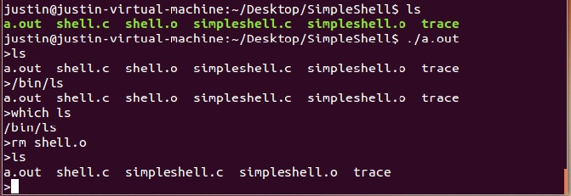
Example Output

Slide 4
Important System Calls
fork()
Create a child process
http://man7.org/linux/man-pages/man2/fork.2.html
exec() family
Have the current process execute the program specified in the pathname
http://man7.org/linux/man-pages/man3/exec.3.html
wait() family
wait() wait the termination of anyone of the child processes
waitpid() waits the termination of the specified child process
http://man7.org/linux/man-pages/man2/waitpid.2.html

Slide 5
Waiting on child processes
If a command is ended with “&”, then the shell will not wait for the child process
For example:
sleep 10s
The prompt re-appears after 10 seconds
sleep 10s &
The prompt re-appears immediately
A child process becomes a zombie if it is not waited by its parent process
How to deal with this problem?

Slide 6
Test Cases
Your shell must correctly handle test cases of the following format
<program> <arg1> <arg2> <…>
Test cases are like the following, but not limited to:
clear
ls -l
cp a.txt b.txt
cat c.txt &
Your shell must not create any zombie processes!

